Slide 1

Advanced Game Prototyping
GA4401

Slide 2

The art of:
Game Polish
What is it?
How do I get it?
When should I do it?

Slide 3
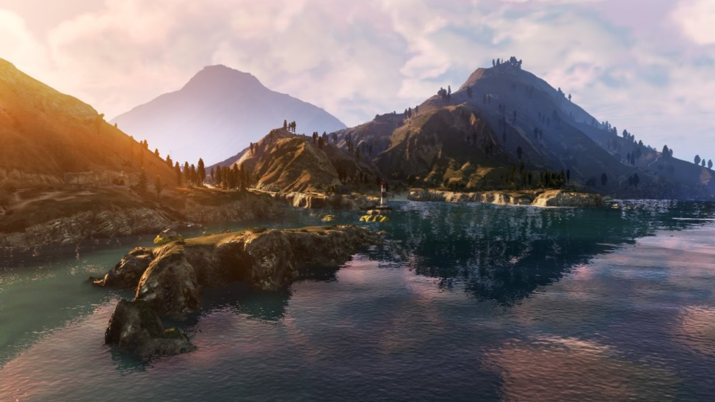

Polish
What is it?
Consistency
Great graphics, great balance.
Notes:
"To me, what defines polish in a game is a consistency of experience," says BioWare's Mark Darrah, executive producer of the Dragon Age franchise. "If you can play a game that has really great graphics but terrible balance, and that's not a very well-polished game because there's something that's pulling you out of the experience. Polish is when everything comes together in a cohesive whole."

Slide 4
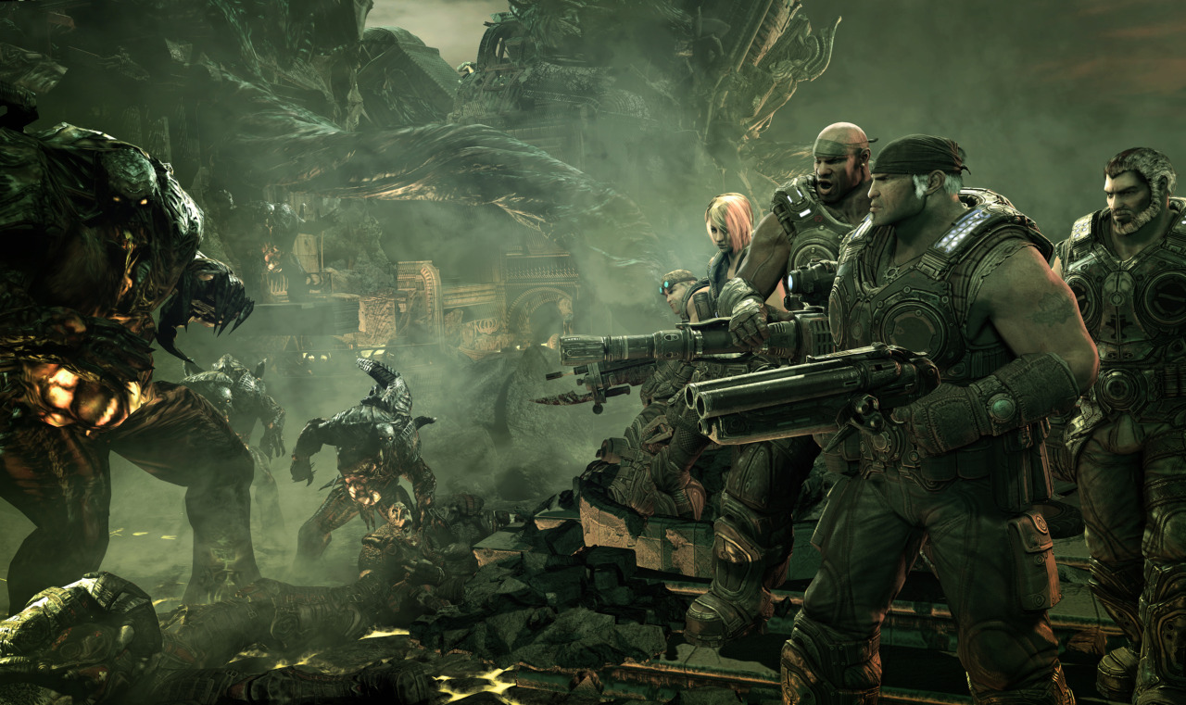
Polish
What is it?
The little details.
Making a good game great.
Notes:
"Polish, to me, is the last 10 to 20 percent of effort where everything in the game is now working and you take the time to focus on the little details that have a big impact on the overall quality of the game," says Rod Fergusson, executive producer of titles including Gears of War 2 at Epic Games. "Polish is extremely important, as it has the ability to take a good game and make it great."

Slide 5
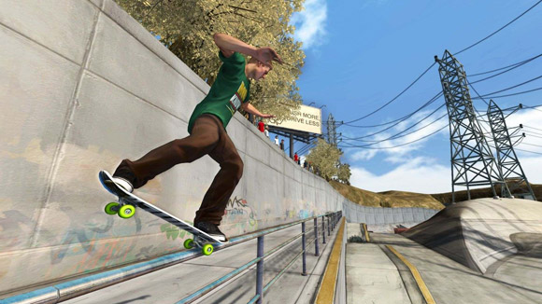
Polish
Disciplines
Design:
Making the game more fun
Notes:
"Different disciplines spend different amounts of time polishing depending on the feature," says Robomodo's Patrick Dwyer, lead designer on Tony Hawk: Ride. "For a designer, polishing means can we make the game more fun. For an artist, polishing means can it look better. For an engineer, polishing means is it optimized."

Slide 6
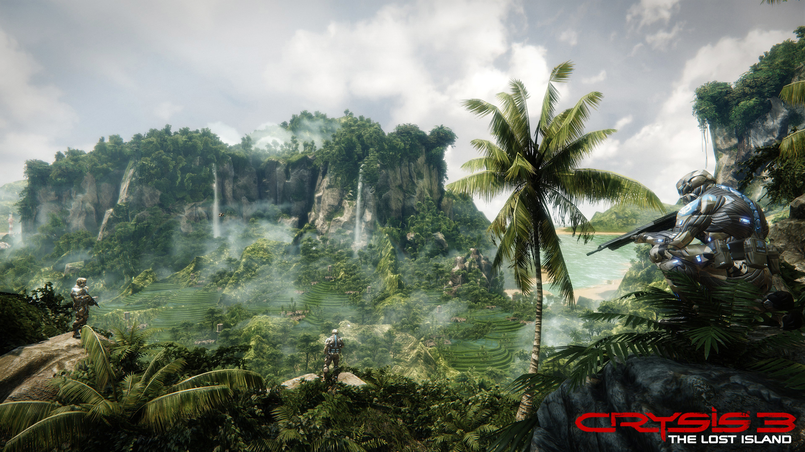
Polish
What is it?
Art:
Making the game look better
Notes:
"Different disciplines spend different amounts of time polishing depending on the feature," says Robomodo's Patrick Dwyer, lead designer on Tony Hawk: Ride. "For a designer, polishing means can we make the game more fun. For an artist, polishing means can it look better. For an engineer, polishing means is it optimized."

Slide 7

Programming:
Making the game more optimized
Notes:
"Different disciplines spend different amounts of time polishing depending on the feature," says Robomodo's Patrick Dwyer, lead designer on Tony Hawk: Ride. "For a designer, polishing means can we make the game more fun. For an artist, polishing means can it look better. For an engineer, polishing means is it optimized."

Slide 8
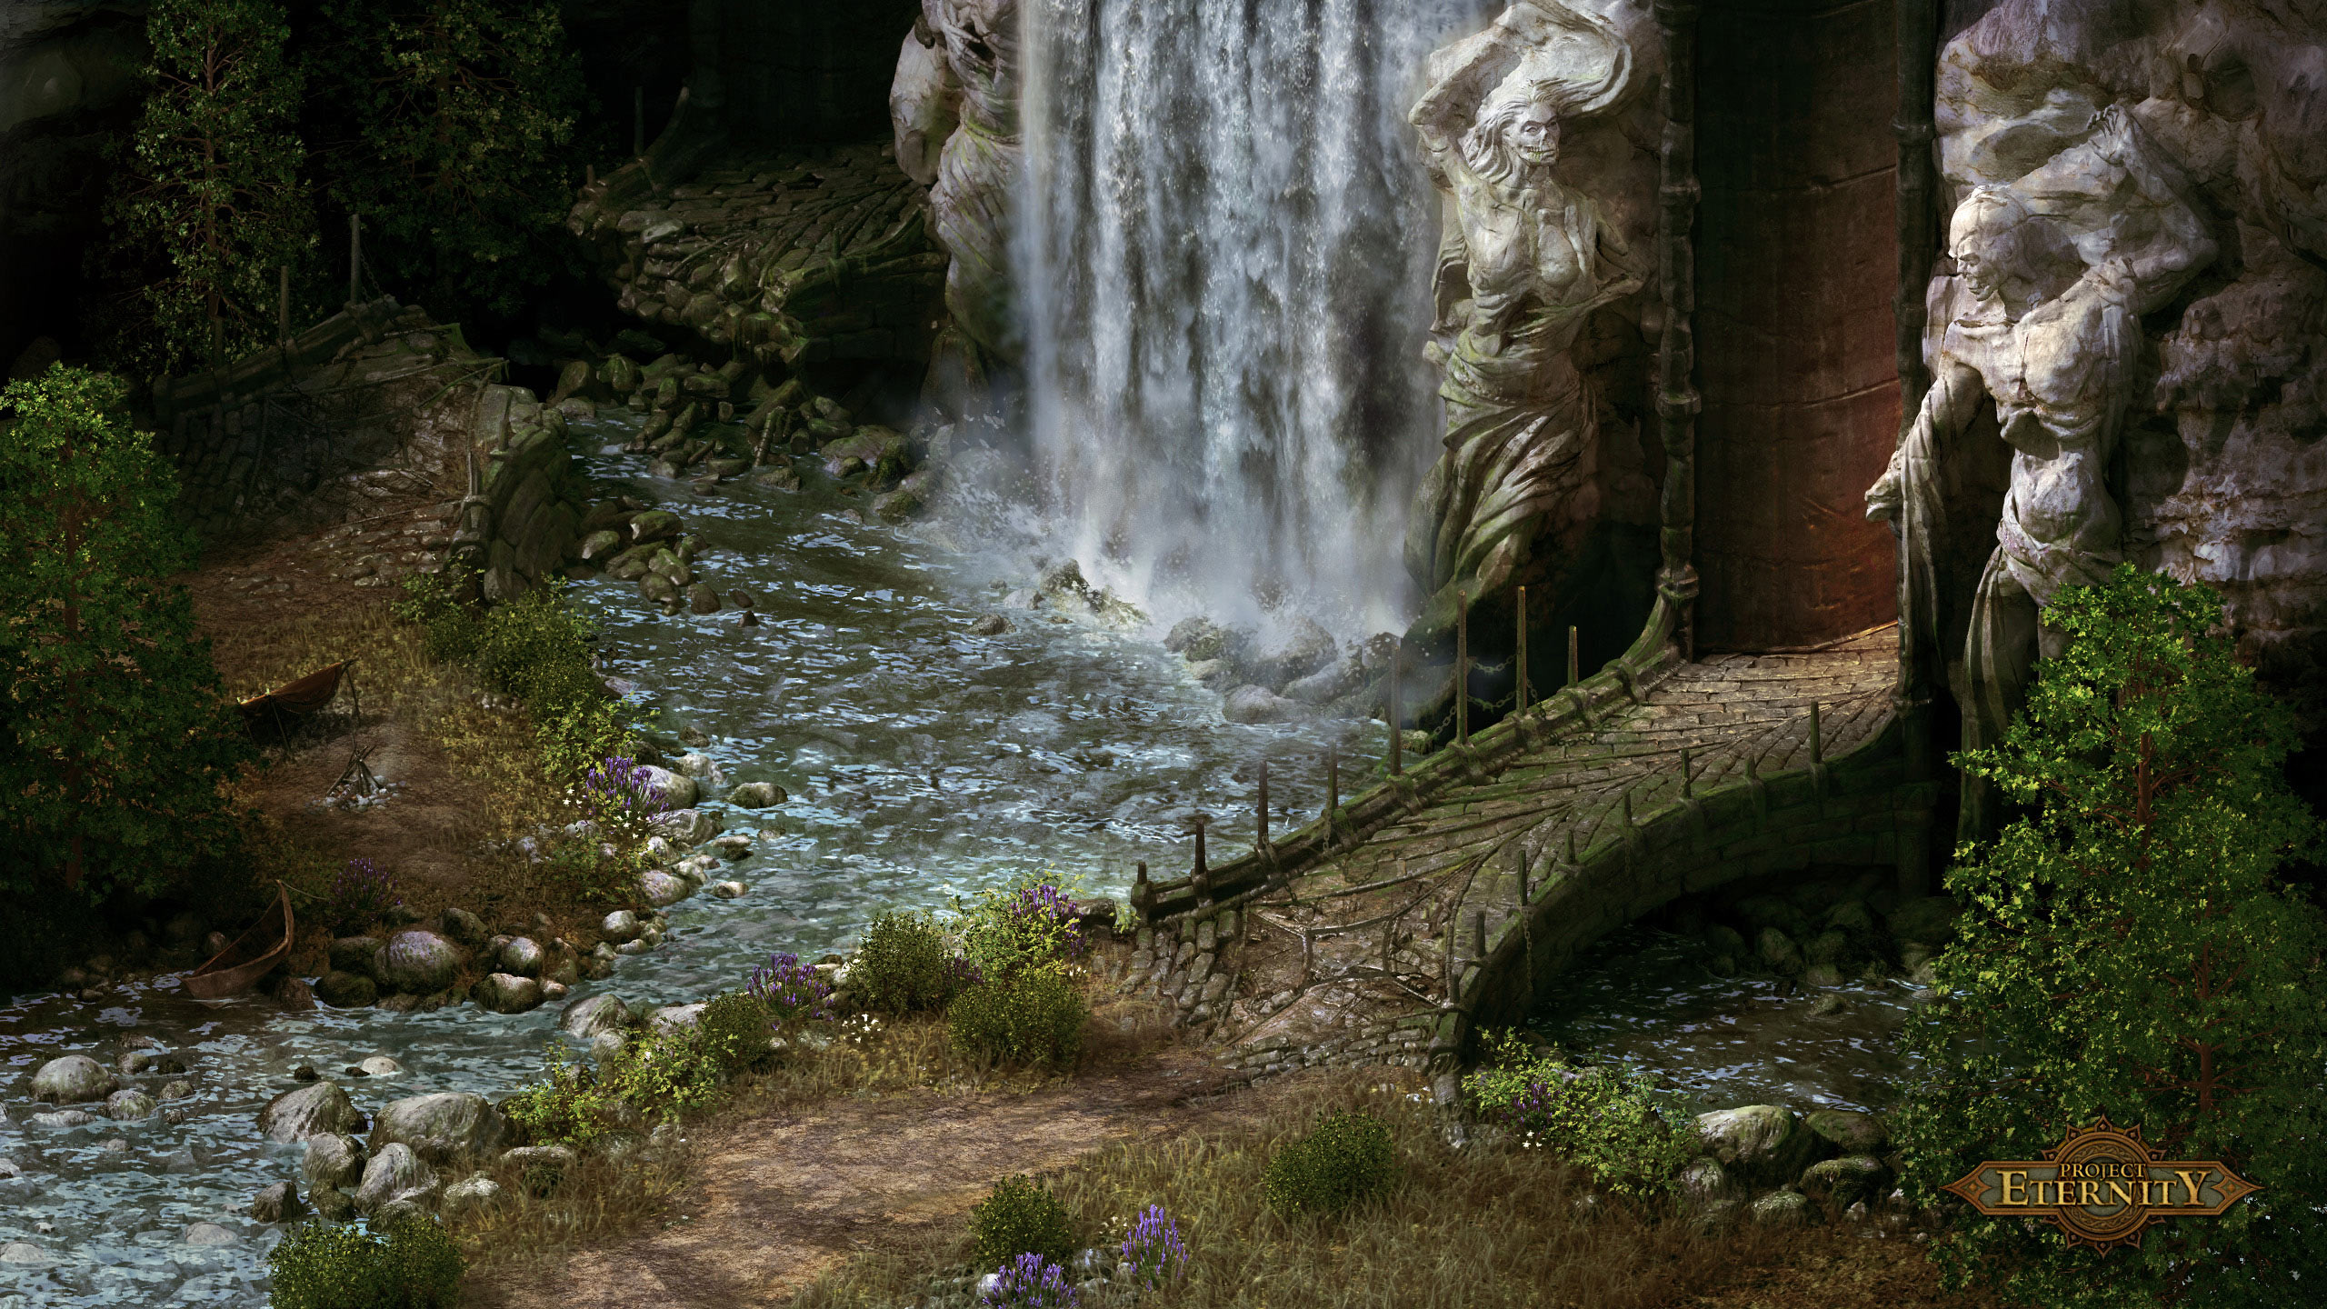
Polish
Small Things x 100
Notes:
For me, polish has always been fixing multiple small issues and adding tiny features that really smooth off the edges of gameplay," says Dan Rubalcalba, programmer on Obsidian's upcoming Alpha Protocol. "I say 'small' in that each issue on their own might not be noticed, but it is the summation of many of them that turns something interesting into something great.
"Also I say 'small' as I consider polish getting a system from 90 percent to 100 percent. But really, that last 10 percent takes just as long as the first 90. Polish is no small task; it is just about small unseen things." Alpha Protocol's lead programmer Frank Kowalkowski added, "Polish is often adding things nobody will ever notice, comment on, or appreciate, but will notice, comment on and appreciate when they aren't there."

Slide 9
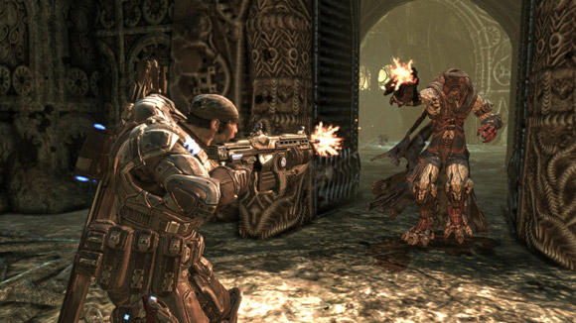
Achieving Polish
Planning
Schedule it
Notes:
"A team achieves polish by allocating time in the schedule for polish, understanding its quality bar and by playing the game over and over. Too often you see polish time as the buffer time in a project schedule, which doesn't really work," says Epic's Fergusson. "Buffer time is required to deal with uncertainty, and even though the quantity of polish required is often uncertain when you're early in your scheduling, those two uncertainties are not the same thing.
"Changes in scope, schedule and resources will eat your buffer time, and you'll still want to have dedicated time outside of that for doing nothing but making the game better through polishing."
Concurring, Robomodo's Dwyer says, "The goal of the developer is set aside time for polish, plan for the unexpected, and be flexible. A team achieves polish by setting priorities based on the high level goals of the game before reaching the 'polish phase.'

Slide 10
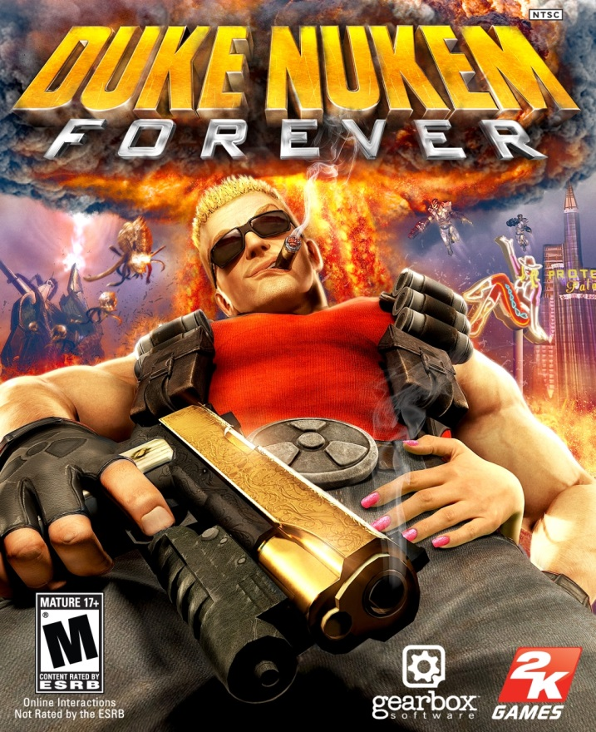
Achieving Polish
How much?
No game is perfect.
Notes:
"Polish is all about planning. There is a deadline by which the game is supposed to be done. When it comes to the 'polish phase,' you don't have time to get every aspect of the game to be one hundred percent perfect.
"As a team, you look at all aspects of the game and your current resources. You make a list of everything that needs to be polished and how much time it will take. You also factor in the importance of polish, meaning how much it affects the overall gameplay experience. You then start prioritizing the work that needs to be done based on all these factors."
As important as it is to allow enough time for polish at the end of the project, it's equally important not to let a team work indefinitely. "It's easy to get caught up in the 'ship it when it's done' mentality, where you claim you are quality-driven. But at the end of the day, no game is ever truly perfect, so when do you ship?" asks Fergusson. "You have to understand what the appropriate quality bar is for your game and how you can effectively use your polish time to achieve it."

Slide 11
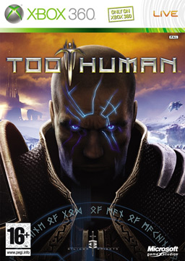
Polish
Reputation
Too much indecision
Competitiveness
Notes:
Gardner continues, "The game industry is so different from some of the other industries out there. It's so competitive. Something that really works now, two years later it might not work at all. It puts a lot of pressure on studios, especially studios that have a reputation to maintain and a sort of quality bar that they have to hit. And what that can lead to is changing direction mid-stream.
"Games that start out to do one thing and just do that thing, and then go with that all the way to the end, that's sort of the ideal scenario. The more meandering you do along the way, like, 'Well, maybe let's make this type of game, or let's do this type of thing, or let's add multiplayer, or let's remove multiplayer.' Those kinds of kinds of changes made along the way, depending on how they're done, that can cause you to waste huge amounts of time and lead to an unpolished product."

Slide 12
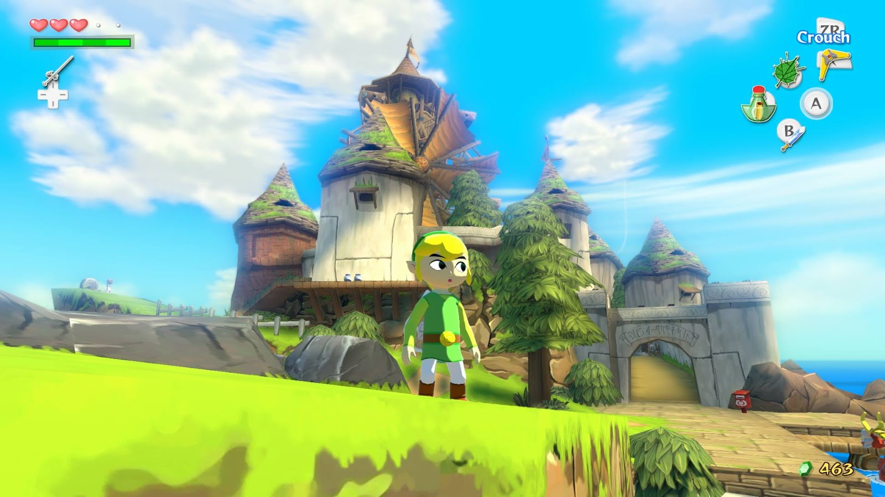
Polish Phase
How?
Character
Triggers
Add Force
Notes:
When a period of time is scheduled for polish at the end of a game project, what exactly is being worked on during that period? Again, our developers had many answers, but all agreed that the final "polish phase" is about stability, performance and smoothing out rough edges.
"I don't have to go into the merits of stability," says Gardner. "We have some very sophisticated tools for checking and predicting stability, better than any other project in BioWare history. I think Dragon Age is our most stable game so far. But it's harder to get a game stable when you're still making changes. At some point you have to restrict your major performance changes, your memory changes or whatever it is, and start just locking things down and fixing stability issues."

Slide 13
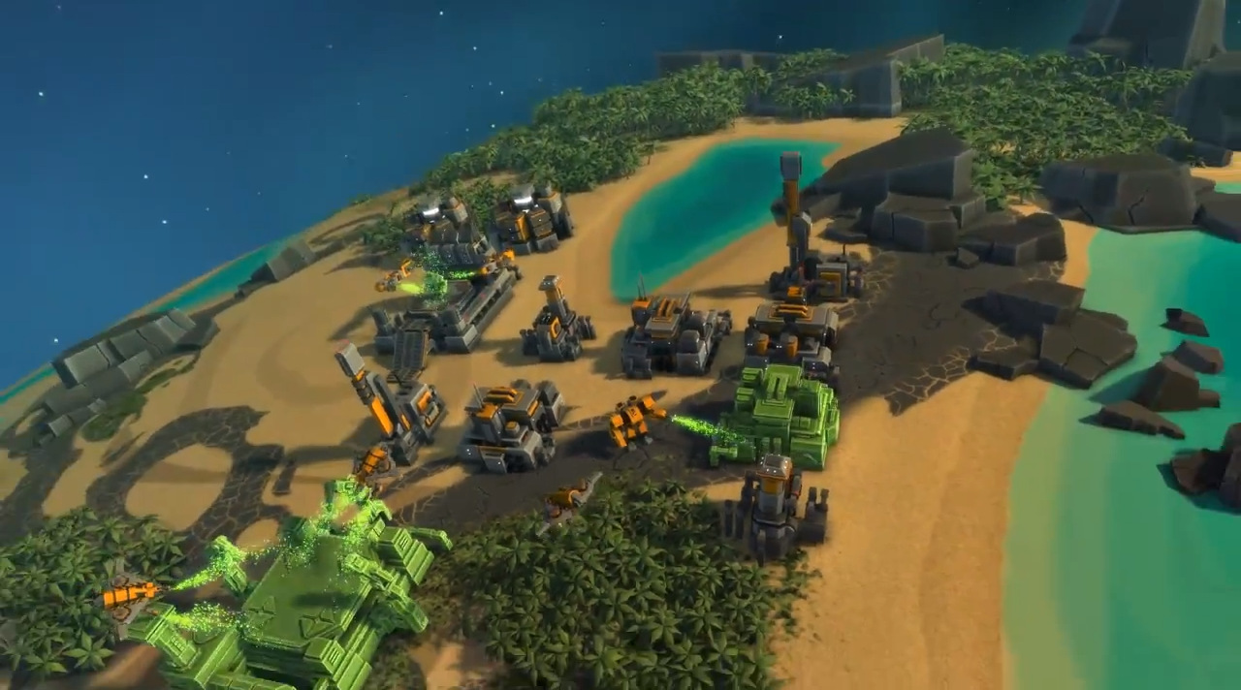
Polish Phase
How to Start?
Group decision vs Organically
Notes:
In BioWare's case, the technical director is responsible for making that decision to lock down development and begin optimization.
"We might make it as a leads group. We have a core leads group, the executive producer, project director, the lead designer, the art director, the lead QA, the online producer," says Gardner. "The core leads group consults on that decision, but essentially it's my responsibility to say that the memory's good enough, and we don't need to work on it anymore.
"And it's not me going into the code and doing that. I've got engineers that work in different areas of the code and one guy who specializes in memory. He'll being doing memory tests and say 'memory's fine,' and that will go to QA so they verify it."

Slide 14
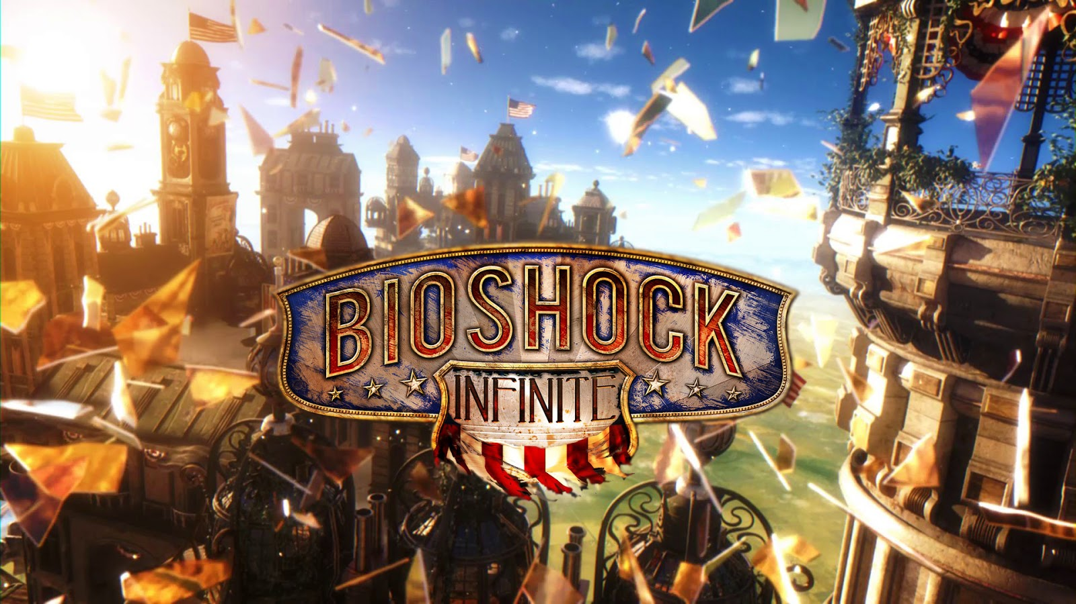
Polish Phase
Cutting + Optimizing
Notes:
Performance and compatibility are two big issues to resolve in the final months, says Frank Kowalkowski, Lead Programmer on Obsidian's Alpha Protocol.
"This is generally the point where we are optimizing code and assets to meet the memory constraints of a console or the performance standards required to be compatible with the minimum system requirements on a PC. There are also the technical checklists required by Sony and Microsoft which are thankfully much less stringent in this generation of consoles.
"This is where you'll often find some of your hardest decision making," says Kowalkowski. "In getting Neverwinter Nights 2 out the door, we had to make the decision to remove support for our 3.0 shader pipeline and support for HDR. Both those decisions were the right ones and helped both programming and art work with a single, common hardware target to get the game done.

Slide 15
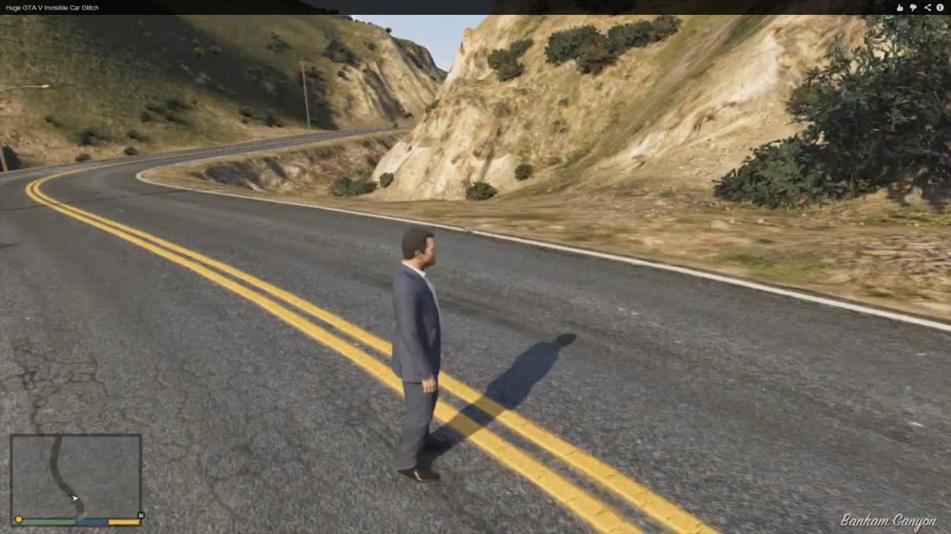
Bugs
(That’s polish too)
But you can’t fix them all….
Notes:
Lastly, programmers spend a lot of time as fixers for the design and art team. This is where we have a creature that isn't rendering properly, quests that have scripts being used in unusual ways, or any number of other scenarios that aren't apparent until you try to finalize a game.
"We've even fixed bugs that designers had exploited for gameplay purposes: the torch lights in the distance during the siege of Crossroad Keep in NWN2 started a bug with rendering particles beyond the fog plane -- when we fixed it we had to then provide support for them to recreate the bug as a feature."
Robomodo's Patrick Dwyer offered up several examples of the issues resolved during this last period of development. "The final technical issues are usually revolve around 'random' interactions, online issues, memory leaks, and memory management," he says. "Physics and other systems applied to the game can create some really interesting situations between the character and the world. Any change to a physics system is extremely dangerous, as the side effects can be well hidden, so figuring out solutions is always tough.
"Online is always difficult just because it is the last thing that is testable due to the fact that the majority of the game must be complete before testing the game online. Memory leaks are just things that creep up once all other systems in the game are stable. Crashes no longer occur due to missing assets and other factors, so now 'deeper' crashes can surface.
"Memory management revolves around handling how the player can save the game and delete it. Making sure that everything works correctly and that the game is notifying the player of all required instructions almost always requires the final game to be in place."
"At the very end of the project, shipping a game comes down to managing risk," Epic's Fergusson says. "You're triaging issues all the time to determine which ones are significant enough that you are willing to introduce the chance for instability by fixing it. After all, any bug fix, no matter how small, often introduces new bugs which then require new fixes, and so on. So, if you have been managing your risk properly, the final technical issues tend to be ones that have the potential to have the greatest impact on the player."

Slide 16
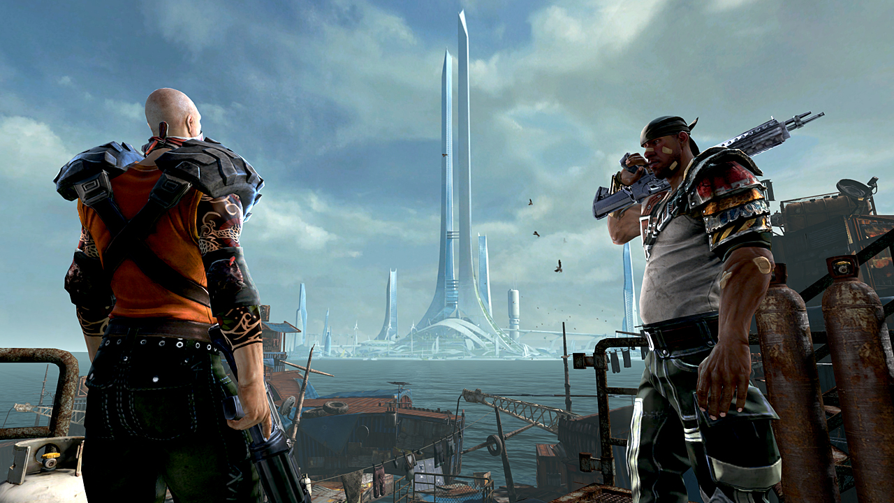
Uh oh.
Running out of time?
Notes:
Of course, sometimes the end of a project doesn't happen when the team initially expects it. Both BioWare's Dragon Age: Origins and Obsidian's Alpha Protocol had been delayed, and both teams had something to say on why their games were delayed and how they changed as a result.
"Obsidian did not make the decision to delay our most recent game, Alpha Protocol," says the game's Producer, Chris Parker. "That sort of decision is made by the publisher and can involve factors that lie outside of the game itself or feedback from focus groups or press. In the past we have lobbied on other games to either move them out or change the development plan, but ultimately the publisher has final say because it's their money the game is being developed with."

Slide 17
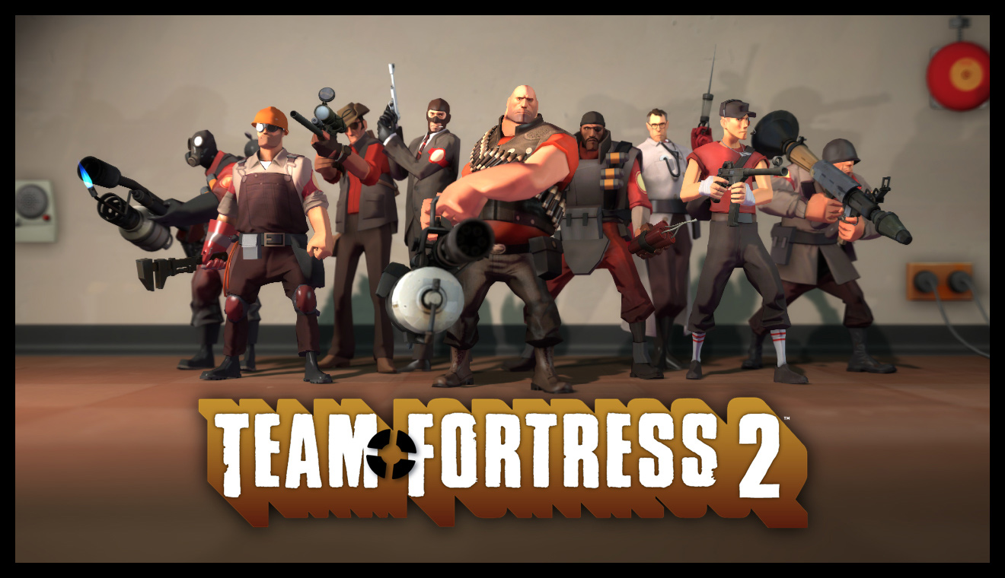
Delays
Reasons for it?
Notes:
There are many reasons games move from their original release date, and only some of them are technical, explains Chris Avellone, creative director at Obsidian.
"Bug count, standards compliance, and media awareness (if a game needs more visibility to sell more numbers) are some that jump to mind," he says. "Localization issues may also play a part. There may be legal issues or a lingering approval process with a franchise or license as well. The release schedule of similar titles in the same genre (both within a publisher and from other companies) may also impact a title's release."

Slide 18
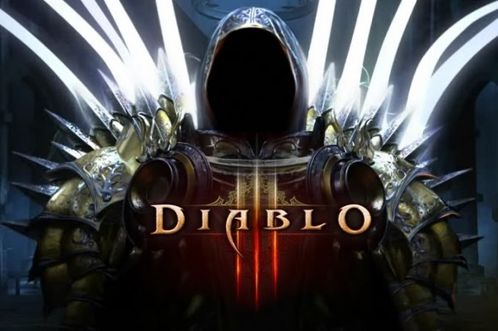
More Delays
Not always clear..
Notes:
Basically there were two main reasons why the PC [version] slipped from March," says Ross Gardner about Dragon Age. "One is that the PC was done by March and we could have shipped it, but it wouldn't have been as polished as it could have been. We said that with a few extra months we could make it a much better game, and fix a lot of the problems.
"The next thing was that if you're pushing it out two months, you might as well push it out to align with all the consoles. I know that a lot of people were upset that they have to wait for the PC version, but there are a lot of really good things about having all SKUs come out at once.
"For instance, you spend a lot of money on marketing. When you try to stretch that between two different dates it makes it much more difficult and much more expensive. So having them all on one day from a marketing perspective is definitely the best.
"At the same time, then some gamers don't feel left out; they all just get it in their hands at the same time. It's kind of a myriad of factors, but the truth is that the PC version is a much more polished product because we've had some time to sit on it and cook it.

Slide 19
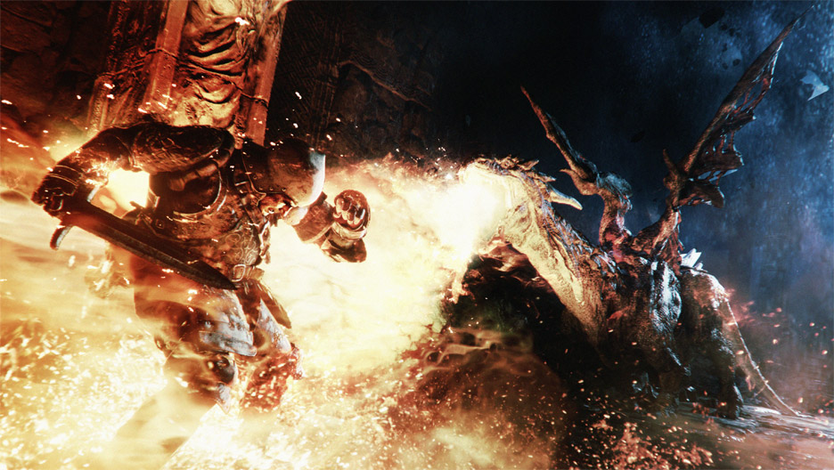
Polish
How do you spot it?
Notes:
Video games are complex, time-consuming projects often involving hundreds of people and millions of dollars, so it's not surprising that there's no simple explanation for what defines polish in a game. In many ways, it's easier to spot where polish is lacking in a game rather than where it is present, as some much of polish is about preventing the player from noticing technical issues. Perhaps Dragon Age lead designer Mike Laidlaw summed it up best by when he said polish is when "You take a game from 'this is functional' to 'this is art.'"

